Slide 1
Lab6
Inter-process communication. Signals.

Slide 2
Introduction
Inter-process communication ensures the transfer of necessary information between one or more processes and can be done in several ways, including: unnamed pipes, named pipes, shared memory, signals, etc..
In this Lab we will study how processes can communicate through signals.
During the last Lab we have studied unnamed pipes.

Slide 3
Signals
Signals are a way of expressing events that occur asynchronously in the system.
Any process can both generate and receive signals.
If a process receives a signal, it can choose to react to that signal in one of three ways:
To capture them, performing a certain action, by means of a signal handling function (signal handler)
He ignores them
Execute the default action when receiving a signal, which may be ending the process or ignoring that signal.

Slide 4
Signal Types
The signals can be of several types, which generally correspond to specific actions.
Each signal is associated with a number, and these numbers correspond to some symbolic constants defined in the operating system libraries.
The POSIX.1 standard defines several signals that must exist in any UNIX system.

Slide 5
These signals are included in the following list:
SIGHUP 1 Hangup - the terminal used by the process has been closed
SIGINT 2 Interrupt - usually means interrupting the process with Ctrl-C
SIGQUIT 3 Quit - means an exit request from the user
SIGILL 4 Illegal Instruction - is generated when the process has executed an instruction whose opcode has no correspondent in the instruction set or for which there are not enough privileges
SIGABRT 6 Abortion - signal for abnormal termination of abortion process (3)
SIGFPE 8 Floating Point Exception - signal generated by a floating-point error (for example, in case of a zero division)
SIGKILL 9 Kill - signal that has the effect of immediately destroying the process
SIGUSR1, SIGUSR2 10, 12 User Defined 1, 2 - signals whose generation and processing are left to the user, usually used to generate various actions in the logic of a process

Slide 6
SIGSEGV 11 Segmentation Fault - is generated when a process referred to an invalid memory address
SIGPIPE 13 Broken Pipe - is generated when attempting to write to a pipe that has the descriptor at the reading end of the pipe closed
SIGALRM 14 Timer Alarm - signal generated after the expiration of the timer positioned by the alarm (2)
SIGTERM 15 Finished - Means a request to terminate the process normally
SIGCONT 18 Continue - Continues a process stopped by SIGSTOP
SIGSTOP 19 Stop - Results in suspending the execution of the process until it is resumed by receiving a SIGCONT signal
The various existing UNIX variants implement these signals, adding new ones. For a list of all existing signals in Linux, for example, see the signal manual page (7)

Slide 7
Signal processing
The ANSI way in which signals can be captured in order to process them is given by the signal system call (). This system call has the following form:
Executing this system call will cause a new treatment routine specified by the handler parameter to be installed for the signal with the signum number specified as a parameter.
The handler parameter must be of type sighandler_t, which means that it must be the address of a function that returns nothing and has a single formal integer parameter.

Slide 8
This parameter will receive as value, at the time of the execution of the signal processing routine, the number of the signal being processed.
This is useful, for example, when you want to process several types of signals using the same routine.
The signal system call () returns the previous signal handling routine, or SIG_ERR in case of error.
There are two special values ​​for the handler parameter, namely:
SIG_IGN, which instructs the process to ignore the specified signal
SIG_DFL, which resets the signal processing to the default behavior

Slide 9
SIG_ERR can be returned, for example, when the signal with the specified number does not exist, or when the specified treatment routine does not have the appropriate type.
SIG_ERR is also returned when the signum is SIGKILL or SIGSTOP, which are signals that can neither be captured nor ignored.
Although the great advantage of the signal system call () over other signal capture methods is its simplicity, its use also has some disadvantages.
One of these is reduced portability.

Slide 10
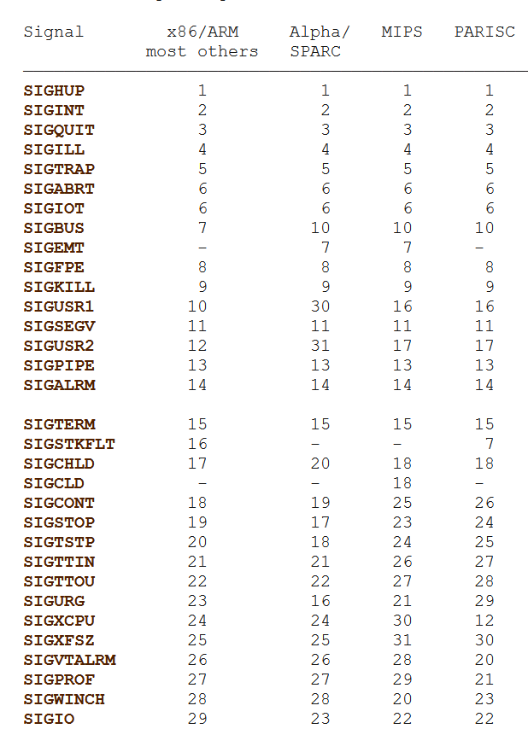

Slide 11
The portability problem occurs because different implementations of this system call in various UNIX systems behave differently when the signal is captured.
For example, the original UNIX implementation (also used by UNIX System V and Linux libc4 and libc5) is that after an execution of the treatment routine, it is reset to the value SIG_DFL, which means that the routine must call signal () before its completion to "reinstall" in order to treat the next occurrence of the signal.
On the other hand, systems in the 4.3BSD family (and Linux glibc2) do not reset the processing routine but blocks the occurrence of that signal during the execution of the processing routine.
The use of signal () is therefore not desirable when writing software that must be easily portable on other versions of UNIX.

Slide 12
System call sigaction()
The next slides will present a signal capture method that offers more flexibility than previously described, by using the sigaction() system call and the calls associated with it.

Slide 13
The sigaction() system call is like the signal() system call.
It is intended to define the behavior of the process upon receiving a signal.
This call receives as parameters the signal number (signum), and two structures of type struct sigaction * (act and oldact).
Its execution will have the effect of installing the new action for the signal specified in the act (if this parameter is not null), and saving the current action in oldact (also, if the parameter is not null).

Slide 14
The struct sigaction structure is defined as follows:
The sa_handler parameter represents the new specified signal handling routine, like the handler parameter presented at the signal ().

Slide 15
Alternatively, if the SA_SIGINFO flag is set in sa_flags (will be shown on the following slides), a routine can be defined that receives three parameters instead of one, and in this case, it is specified by the sa_sigaction parameter.
For more details on using the latter method, see the sigaction manual page (2).

Slide 16
The sa_flags parameter will specify a set of indicators that affect the behavior of the signal processing process.
This parameter is formed by performing a logical OR operation using one or more of the following values:
SA_NOCLDSTOP - if the signum is SIGCHLD, the process will not receive a SIGCHLD signal when the child process is suspended (for example with SIGSTOP), but only when it finishes its execution
SA_RESETHAND - will have the effect of resetting the signal processing routine to SIG_DFL after the first run of the routine, like the behavior of the original implementation of the signal call (); (SA_ONESHOT is an obsolete, nonstandard synonym for this flag).

Slide 17
SA_ONSTACK - the execution of the treatment routine will take place using another stack;
SA_RESTART - offers compatibility with signal behavior in 4.3BSD family systems;
SA_NOMASK or SA_NODEFER - the signal in question will not be automatically included in sa_mask (the default behavior is to prevent the appearance of a signal during the execution of the signal processing routine);
SA_SIGINFO - is specified when you want to use sa_siginfo instead of sa_handler.
For more details, see the sigaction manual page (2).

Slide 18
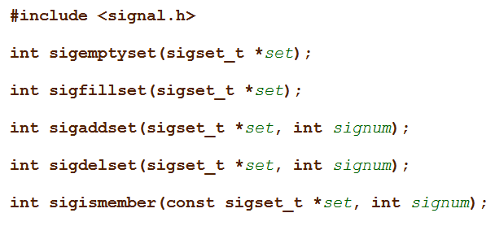
The sa_mask parameter will specify the set of signals that will be blocked during the execution of the given signal processing routine.
This parameter is of type sigset_t, which is a bit mask, with one bit for each signal defined in the system.
The operations on this type of mask are done using the functions from the sigsetops family (3).

Slide 19
The sigprocmask() call is used to change the list of signals that are blocked at a time.
This is done depending on the value of the how parameter, as follows:
SIG_BLOCK - adds to the list of blocked signals the signals from the set list given as a parameter
SIG_UNBLOCK - deletes from the list of blocked signals the signals in the set list
SIG_SETMASK - causes only the signals in the set list to be in the blocked signal list.
If the oldset parameter is not null, it will store the value of the list of blocked signals prior to the execution of sigprocmask ().

Slide 20
The sigpending() system call allows the examination of the signals that appeared during the time when they were blocked, by returning these signals in the set data mask as a parameter.
The sigsuspend() call temporarily replaces the mask of the blocked process signals with the one given in the mask parameter and suspends the process until a signal is received.

Slide 21
The calls sigaction(), sigprocmask() and sigpending() return the value 0 in case of success and -1 in case of error.
The sigsuspend () call always returns -1, and normally the variable errno is set to EINTR.
Following execution with errors of one of the above calls, the variable errno can take one of the following values:
EINVAL - when an invalid signal was specified, ie not defined in the current implementation, or one of the SIGKILL or SIGSTOP;
EFAULT signals - when one of the variables given as a parameter points to a memory area that is not part of the address space of the process;
EINTR - when the call was interrupted.

Slide 22
Other functions for working with signals
This system call is used to send a signal to a specific process or group of processes.
Depending on the value of the pid parameter, the execution of the call will have one of the following effects:
If pid > 0, the signal will be sent to the process that has the PID equal to pid;
If pid == 0, the signal will be sent to all processes in the same process group as the current process;
If pid == -1, the signal will be sent to all processes running in the system
(note that, in most implementations, a signal cannot be sent in this way to the init process for which it does not have a treatment routine, and the fact that usually the current signal is not sent to the current process);
4. If pid < -1, the signal will be sent to all processes in the process group with the number -pid.

Slide 23
If the value of sig is zero, no signal will be sent, but the call will perform the error checks.
This is useful if you want to know, for example, if we have enough permissions to send a signal to a given process.
This call returns 0 in case of success and -1 in case of error, setting the errno variable to one of the following values ​​in case of error execution:
EINVAL - in case of specifying an invalid signal
ESRCH - in case the specified process or group of processes does not exist
EPERM - if sufficient permissions are not available to send the signal to the specified process

Slide 24
This function is used to send a signal to the current process
Its execution is like the execution of the following call: kill (getpid (), sig)
The function returns 0 in case of success, and a non-zero value in case of error

Slide 25
This function has the effect of sending a SIGABRT signal to the current process, which has the effect of terminating the process abnormally, unless the signal is processed by a routine that does not end.
If the execution of abort () has the effect of ending the process, all open files inside it will be closed.
It is important to note that if the SIGABRT signal is ignored or blocked, the execution of this function will not take this into account and the process will be terminated abnormally.

Slide 26
Execution of this function results in the sending, after several seconds specified by the unsigned int parameter seconds, of a signal of type SIGALRM to the current process.
If an alarm has already been scheduled, it is canceled at the time of the last call, and if the value of seconds is zero, no new alarm will be scheduled.
After execution, the number of seconds remaining from the previous alarm is returned, or 0 if no alarm was programmed.

Slide 27
Example (Long one)
The program highlights how to use the signal() function and communication between processes using signals.
The program consists of two processes, parent and son.
The parent (process A) counts continuously from zero, until it is interrupted by the user.
The interruption is made by generating the SIGINT signal to the process, explicitly (using the kill command) or implicitly (pressing Ctrl-C in the console where the program is running launched in foreground).
For optimal visualization of the results, at each step the process calls the usleep() function, thus generating a delay of 1000 microseconds.

Slide 28
Each time process A reaches a number divisible by 10 with the numerator, it sends a SIGUSR1 signal to process B (son).
B Processes the SIGUSR1 signal by displaying a message on the screen.
If the parent has been interrupted (from the keyboard, via Ctrl-C, for example), he informs his son of the occurrence of this event by sending him the SIGUSR2 signal.
The son receives this notification and ends, displaying a message.
The father takes over his condition at this moment, after which he also ends.

Slide 29
It is necessary to make some important remarks on the implementation following.
First, the program defines a treatment function for each relevant event:
The process associates the SIGINT signal with the process_a_ends() function. According to the code of this function, when receiving the SIGINT signal, the process will send a SIGUSR2 signal to process B, after which it calls the wait () function, waiting for its completion.
Process b defines two processing functions:
for SIGUSR1 (process_b_writes () function)
For SIGUSR2 (process_b_ends () function)
The behavior of these functions is trivial, reducing to the display of a message and, in the second case, to the end of the process by exit ().

Slide 30
Secondly, it is observed that process B ignores the SIGINT signal.
The reason for this was decided to make him immune to the implicit action that this signal could have on the process.
An unwanted effect would be if the user presses Ctrl-C in the console from which he launched the program, thus generating SIGINT.
If the signal were not ignored, process B would end before it had a chance to receive SIGUSR2 from the parent, so its termination would not respect the scenario that it proposed to implement this application (the visible effect would be that the message "Process B ends" would no longer appear on the screen).

Slide 31
Next, it should be noted that at the beginning of the main program, even before the child process is created, the SIGUSR1 and SIGUSR2 signals are ignored.
This code sequence may seem unimportant, but its necessity is justified by the more unpredictable effects of parallel process execution.
In order to understand the explanation, it must first be stated that, in Linux, after calling the fork () function, the child process is initialized with a copy of the signal-function associations for treatment found in the parent.

Slide 32
If the signals SIGUSR1 and SIGUSR2 were not ignored before the creation of the son process, the following phenomenon could occur:
processes A and B are created in a very short time, and the process A ends up executing before B.
A counts quickly and reaches a multiple of 10 before process B arms its signal processing functions.
Process A sends the signal SIGUSR1 to B but as it has not yet declared any function for processing this signal, the operating system will proceed by applying the default signal behavior, ie terminating process B.
It is observed, therefore, that process B ends erroneously, before fulfilling its purpose for which it was designed.
If, however, the SIGUSR1 signal is already ignored, in the worst-case process B loses some notifications from A which, considering the parallel execution of the processes, can be accepted in our scenario.

Slide 33
One last observation is that the result of the fork () function is assigned in the program to a global variable child_pid so that this value can be accessible to both signal processing functions in process A. (Since process A is the parent, the value of this variable will be the process identifier of B).

Slide 34
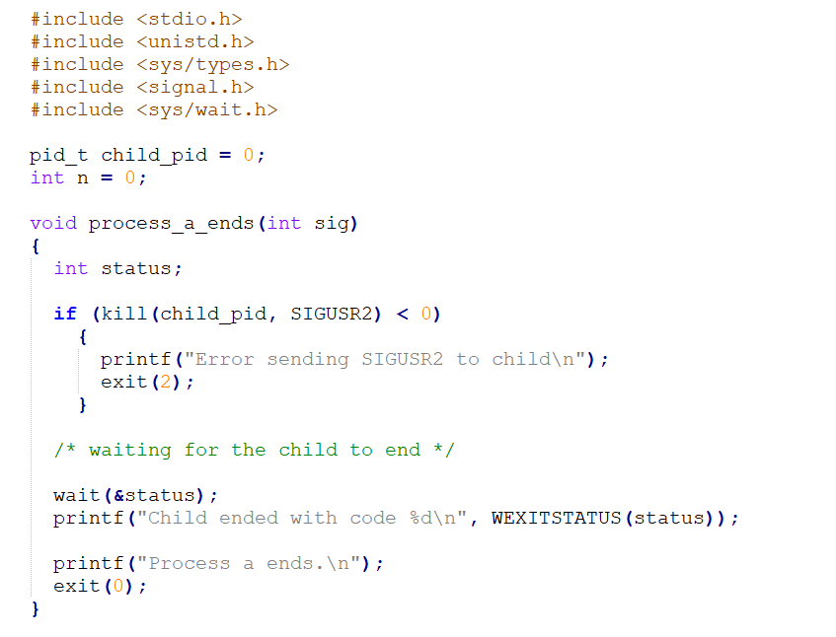

Slide 35
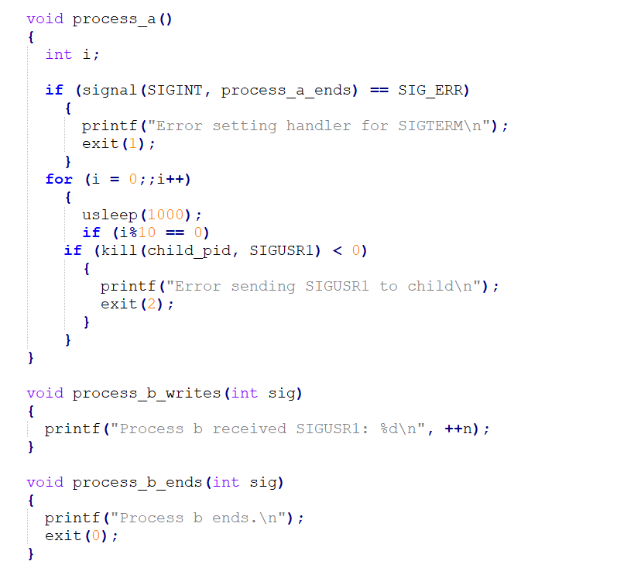

Slide 36
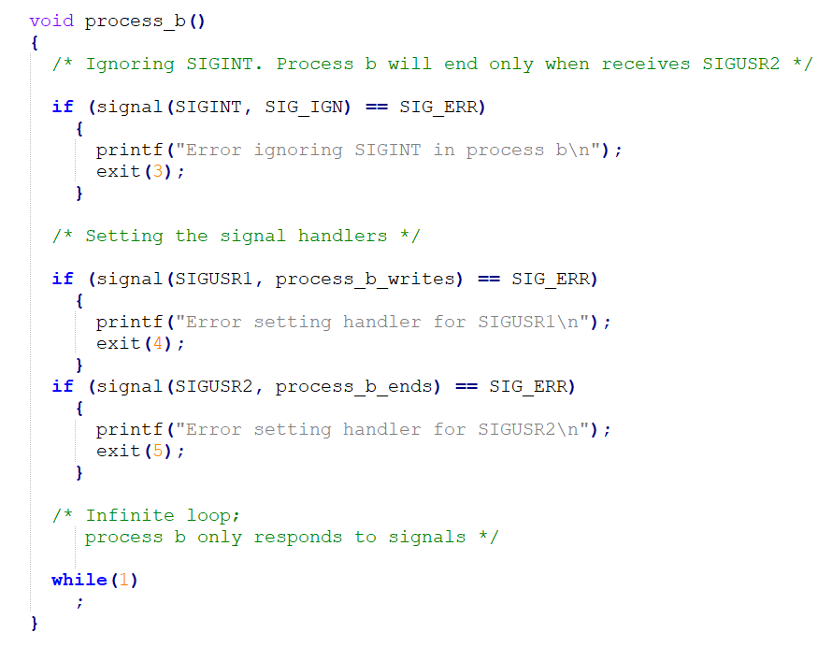

Slide 37
