Slide 1
Lab5
Pipes in UNIX

Slide 2
Introduction
A very common method used in UNIX for communication between processes is to use primitives called pipes.
A “pipeline" is a link that can be established between two related processes (that have a common ancestor or are in the ancestor-descendant relationship).
A pipe has two ends, one through which data can be written and another through which data can be read, allowing communication in one direction.

Slide 3
Introduction
In general, the operating system allows one or more processes to be connected to each end of a pipe, so that at a given time it is possible to have several processes that write or several processes that read from the pipe.
Thus, one-way communication is achieved between the processes that write and processes that read.

Slide 4
System call pipe()
Creating pipes in UNIX is done using the pipe() system call:
The function creates a pipe, as well as a pair of file descriptors that refer to its two ends.
The descriptors are returned to the calling program by filling in the two positions of the sent array as a parameter to the system call.

Slide 5
System call pipe()
On the first position the descriptor that indicates the end through which data can be read (end of reading), and on the second position there will be stored the descriptor for the writing end.
The two descriptors are common file descriptors, like those returned by the open() system call.
Moreover, the pipe can be used in a similar way to the use of files: data can be written using the write() function (applied to the write end) and data can be read through the read() function (applied to the read end).

Slide 6
System call pipe()
As regular file descriptors are involved, if a pipe is created in a parent process, its children will inherit the two descriptors (as they generally inherit any file descriptor opened by the parent).
Therefore, both the parent and the children will be able to write or read from pipes.
This justifies the statement made at the beginning of this document that it was said that pipes are used to communicate between related processes.

Slide 7
System call pipe()
For the connection between the processes to be done correctly, each process must declare whether it will use the pipe to write in it (transmitting information to other processes) or will use it only for reading.
To do this, each process must close the end of the pipe that it does not use: processes that write to the pipe will close the read end, and processes that read will close the write end, using the close() function.
The function returns 0 if the creation operation was successful and -1 in case of error.

Slide 8
System call pipe()
A possible scenario for creating a system consisting of two related processes that communicate through pipes would be:
the parent process creates a pipe
the parent calls fork() to create the child
son closes one end (eg reading end)
the parent closes the other end of the pipe (the writing one)
son writes data in pipes using the descriptor left open (end of writing)
the parent reads data from the pipes through the reading end.
The primitive pipe behaves similarly to a queue data structure: writing introduces elements into the queue, and reading extracts them at the opposite end.

Slide 9
Here is a portion of the program written according to the above scenario:

Slide 10
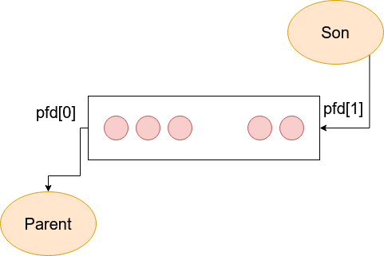
The connection between the two processes that make up the above program is reflected in the following figure:

Slide 11
Observations
The amount of data that can be written to a pipe at a time is limited.
The number of bytes that a pipe can store without being extracted by reading by a process is system (implementation) dependent.
The POSIX standard specifies the minimum capacity limit of a pipe: 512 bytes. When a pipe is "full", the write() operation will crash until another process reads enough bytes from the pipe.
A process that reads from the pipe will receive the value 0 as the value returned by read () when all the processes that were writing to the pipe closed the write end and there is no more data in the pipe.

Slide 12
If for a pipe, only processes are connected to the write end (those at the opposite end have closed all the connection) the write operations performed by the remaining processes will return error. Internally, in this situation the SIG_PIPE signal will be generated which will interrupt the respective write system call. The resulting error code (set in the global variable errno) is the one corresponding to the error message "Broken pipe".
The pipe write operation is atomic only if the number of bytes written is less than the constant PIPE_BUF. Otherwise, in the string of written bytes, the data written by another process can be inserted in the pipe. For details, refer to the pipe manual (7).

Slide 13
Redirecting file descriptors
It is known that the open() function returns a file descriptor. This descriptor will indicate the open file with open() until the end of the program or until the file is closed.
However, the UNIX operating system offers the possibility for any descriptor to point to a file other than the usual one.
The operation is called redirection and is most often used in the case of file descriptors with values ​​0, 1 and 2 which represent standard input, standard output and, respectively, standard error output.
Also, the operation of duplicating file descriptors is used, which determines the existence of more than one descriptor for the same file.

Slide 14
Redirecting file descriptors
In fact, redirection be a particular case of duplication.
Duplication and redirection are done, depending on the requirements, using one of the following system calls:

Slide 15
dup()
The dup() function duplicates the oldfd descriptor, returning the new descriptor.
This means that the returned descriptor will point to the same file as oldfd, both the new and the old descriptor sharing the pointer position in the file, the file flags, and so on.
If the position in the file is changed by means of the lseek() function using one of the descriptors, the effect will be observed for the operations performed using the other descriptor.
The new descriptor assigned by dup() is the smallest free (closed) descriptor available.

Slide 16
dup2()
The dup2() function behaves similarly to dup(), except that it can be explicitly indicated which is the new descriptor.
After the dup2() call, the newfd descriptor will point to the same file as oldfd.
If before the operation the newfd descriptor was open, the indicated file is closed first, after which the duplication is made.
Both functions return the newly created descriptor (in the case of dup2(), equal to newfd) or -1 in case of error.

Slide 17
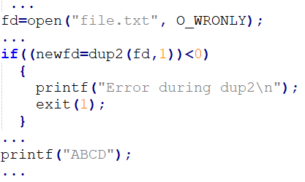
The following code sequence redirects the standard output to an open file, with the corresponding fd descriptor:
Following the redirect, the text "ABCD" printed with printf() will not be written on the screen, but in the file named “file.txt".

Slide 18
File redirects are preserved even after calling an exec() function (which overwrites the current process with the program taken from disk).
Using this feature, it is possible, for example, to connect two processes through pipes, one of them running an executable program read from disk.
It may be considered that the parent opens a pipe from which he will read data, and the son is a process that executes a program on the disk.
Code example on the following slides.

Slide 19
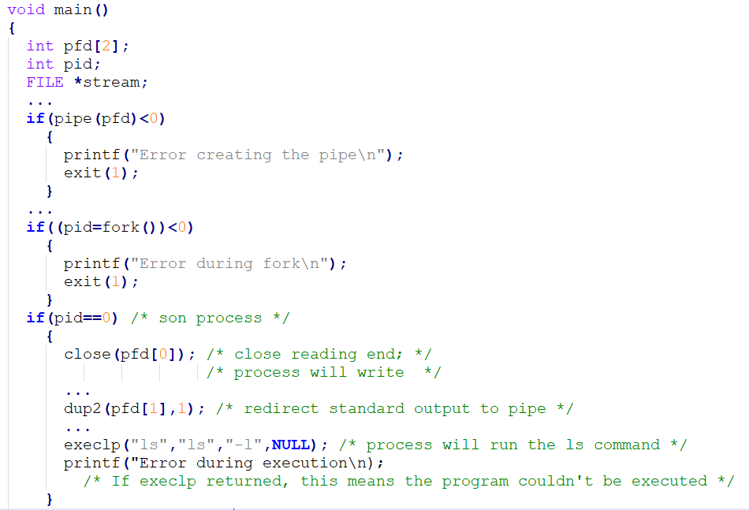
Everything that the process read from the disk gets displayed at the standard output and will be redirected to the write end of the pipe, so that the parent can read the data produced by it. Didn’t close writing end in son code (This is a mistake).

Slide 20
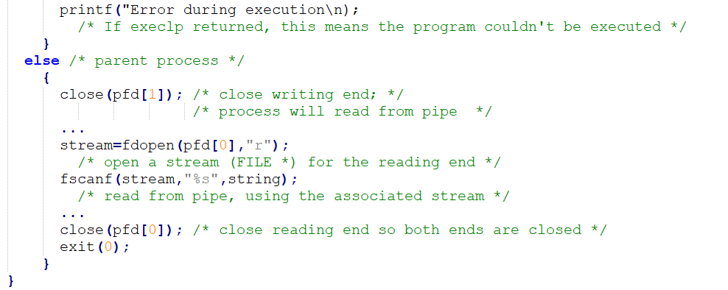
The fdopen() function was used to be able to use the advantages of library functions for working with files in the case of a file (pipe read end) indicated by an integer descriptor (in this case, it was wanted to perform a formatted read, with fscanf(), from pipe).

Slide 21
To do:
Try to use pipe() and fork() together in two ways:
Parent writes to pipe and son reads from it
Son write to pipe and parent reads from it

Slide 22
